Slide 1

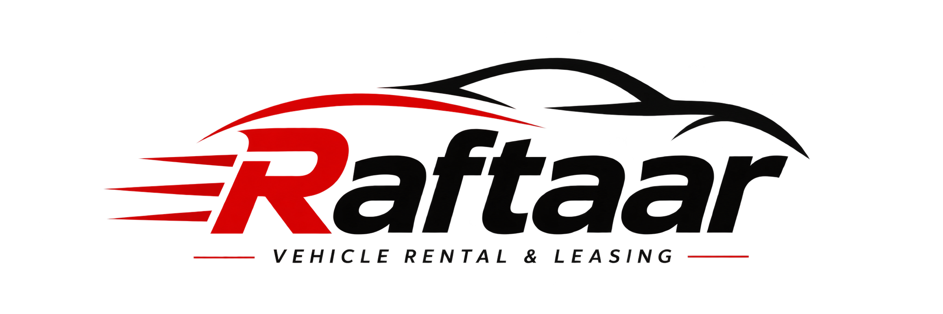
Raftaar – Drive Your Journey.
SUBMITTED BY:- YASHODEV ROUT
BRANCH:- CSE
SECTION:- GENIUS
REGD NO:- 2301298606
ORGANIZATION:- MINDBRAIN INNOVATIONS PRIVATE LIMITED
NAME OF INTERNAL GUIDE:- MR. SWARNANANDA MUDULI

Slide 2
Content
Introduction
Project Overview
Objectives
Technologies and Tools Used
Results and Findings
Diagram
Summary Of Internship
Conclusion
Future Directions

Slide 3
Introduction
About the Organisation – MindBrain Innovations Pvt. Ltd.
A software development company based in Bhubaneswar, Odisha.
Focuses on developing web-based applications and digital solutions.
Provides opportunities for practical learning and industry exposure.
Emphasizes teamwork, collaboration and continuous learning.
Technology areas include web development, frontend and backend development, and software solutions.
Why Summer Internship is Essential
Provides hands-on experience with real-world projects.
Improves technical, communication and problem-solving skills.
Helps understand professional workflows, teamwork and project development.

Slide 4
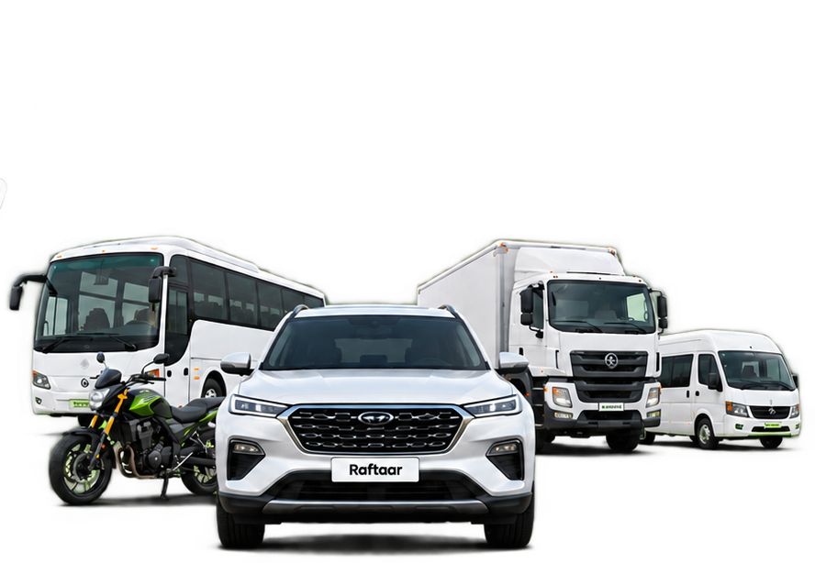
Project Overview
Raftaar is an all-in-one vehicle rental and leasing marketplace that connects customers with vehicle owners, offering convenient access to personal and commercial vehicles through a single platform.
Multiple vehicle categories – Cars, Bikes, Trucks, Buses and more.
Easy vehicle search and filtering.
Flexible rental durations and pricing.
Doorstep delivery and pickup facilities.
Short-term rentals and long-term business leasing.

Slide 5
Objectives
Background
Gain real-world industry experience and understand how client projects are handled at the industry level.
Apply academic knowledge to practical projects and business requirements.
What Was Learnt – Key Achievements
Gained hands-on experience in HTML, CSS, JavaScript and GitHub.
Practiced frontend development by completing 34+ minor projects.
Improved coding, debugging, teamwork and problem-solving skills.
How Skills Will Be Practiced – Future Strategy
Work on real-world projects and industry-based tasks.
Strengthen skills in React.js, Node.js, Express.js and MongoDB

Slide 6


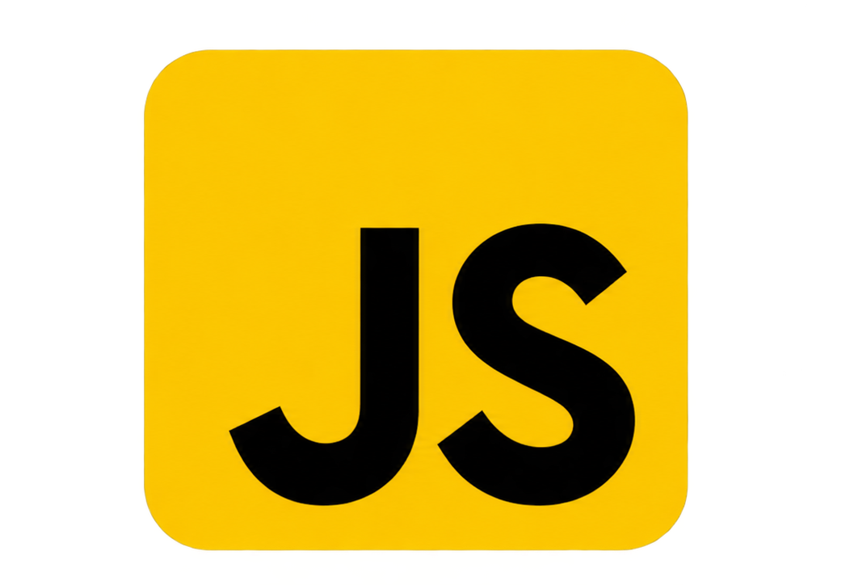


Technologies and Tools Used
Technologies
HTML5 – Website structure.
CSS3 – Styling, layout and animations.
JavaScript – Interactivity and functionality.
Development Tools
Visual Studio Code – Code editor.
Git & GitHub – Version control and code management.
Vercel – Deployment

Slide 7
Results and Findings
Results
Designed an all-in-one platform supporting multiple vehicle rental and leasing options.
Created Login and Registration pages for user access.
Developed Explore Vehicles and Vehicle Details pages for enquiries.
Added a Lease facility for long-term vehicle requirements.
Key Findings
A single platform simplifies vehicle discovery and rental.
Filtering improve the user experience.
Detailed vehicle information helps customers make better decisions.
Responsive design improves accessibility across devices.
Raftaar →

Slide 8
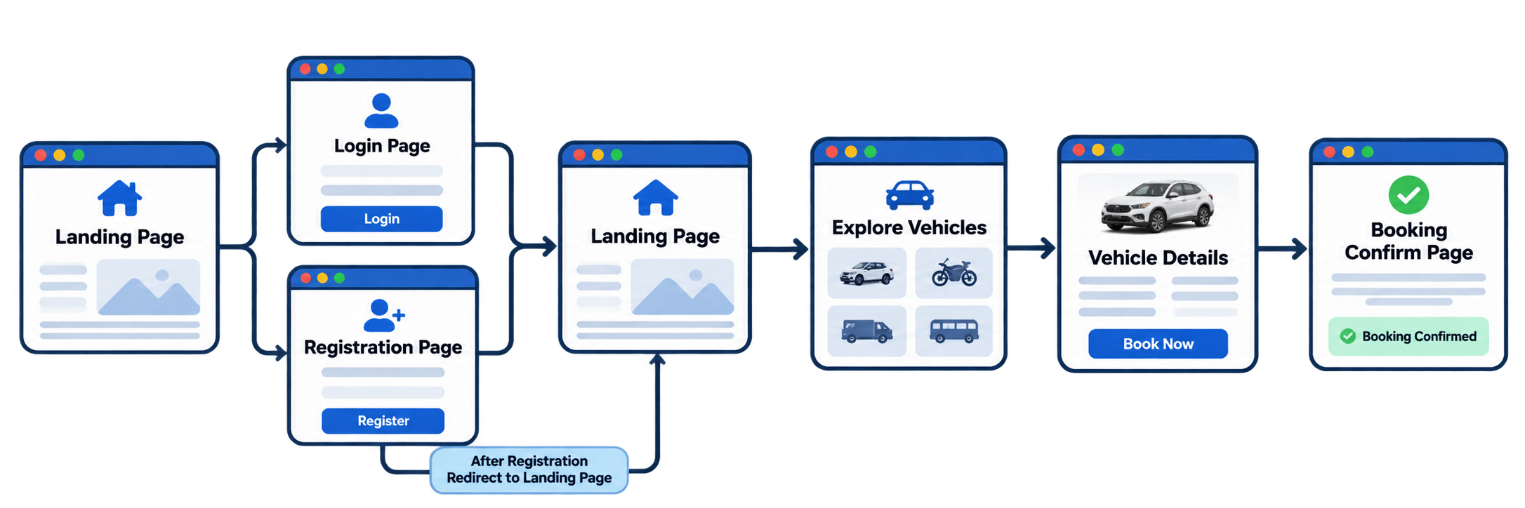
Diagram

Slide 9
Summary of Internship
MindBrain Innovations Private Limited
Role: MERN Stack Development Intern
Gained practical experience in frontend web development.
Learned and applied HTML, CSS, JavaScript, Git and GitHub.
Successfully completed 34+ minor projects.
Developed Raftaar, a vehicle rental and leasing marketplace.
Improved teamwork, communication and problem-solving skills.
Overall Learning: Gained hands-on industry experience and strengthened technical and professional skills through practical development projects.

Slide 10
Conclusion
Successfully completed the first 2.5 months of internship at MindBrain Innovations Pvt. Ltd.
Gained practical experience in frontend development using HTML, CSS and JavaScript.
Completed 34+ minor projects and developed the Raftaar project.
Continuing to strengthen development skills through practical industry experience.
Key Takeaway: Building a strong technical foundation through practical learning, continuous improvement and industry exposure.

Slide 11
Future Directions
Main Focus: Transform Raftaar into a scalable, production-ready vehicle rental and leasing marketplace using the MERN stack.
Full-Stack Development: Implement MongoDB, Express.js, React.js and Node.js.
Authentication & Security: Implement JWT authentication and role-based authorization.
Advanced Functionality: Develop vehicle management, real-time availability, booking and leasing workflows.
Payment Integration: Integrate Razorpay for secure online transactions.
Cloud Integration: Use Cloudinary for vehicle images and media management.

Slide 12
THANK YOU

